Slide 1


SRI RAMAKRISHNA ENGINEERING COLLEGE
[Educational Service: SNR Sons Charitable Trust]
[Autonomous Institution, Reaccredited by NAAC with ‘A+’ Grade]
[Approved by AICTE and Permanently Affiliated to Anna University, Chennai]
[ISO 9001-2015 Certified and all eligible programmes Accredited by NBA]
VATTAMALAIPALAYAM, N.G.G.O. COLONY POST, COIMBATORE – 641022.
DETECTION OF TIRE DEFECTS USING DEEP LEARNING
Team members:
BRINDHA S (71812205017)
MONIKA M (71812205057)
MUTHUMARI S (71812205061)
Mentor:
Dr. J. Angel Ida Chellam, Associate. Prof, IT.

Slide 2
AGENDA
ABSTRACT
Introduction
Problem STATEMENT
Problem SOLUTION
Objectives
Literature Survey
Methodology
modules
Output screenshots
Conclusion
Future scope
References

Slide 3
ABSTRACT
Tire defects, such as cuts, bulges, and punctures, pose significant safety risks to vehicles and passengers. Early detection of these defects is crucial for maintaining road safety and preventing accidents. However, manual inspection of tires for defects is time consuming, labor-intensive, and prone to human error. Therefore, there is a need for an automated tire defect detection system that can accurately and efficiently identify various types of defects in real-time. The YOLOv8 algorithm, an evolution of the popular You Only Look Once (YOLO) object detection family, is particularly well-suited for real-time tire defect detection in images. Its key strength lies in its ability to detect multiple objects within an image simultaneously with high accuracy and speed.in the culinary preferences and skill levels.

Slide 4
INTRODUCTION
Tire defects are a significant concern for vehicle safety, as they can lead to accidents, breakdowns, and increased maintenance costs. Common tire defects include cuts, punctures, bulges, and uneven wear, which can compromise the structural integrity of the tire and increase the risk of blowouts. Traditional methods of detecting tire defects rely on manual inspection, which is time-consuming, labor-intensive, and prone to human error Automated tire defect detection systems use image processing techniques to analyze digital images of tires and identify defects. In which the systems can provide more accurate and consistent results compared to manual inspection methods, leading to improved safety and reduced maintenance costs. This project focuses on the development of an automated tire defect detection system using image processing techniques.

Slide 5
PROBLEM STATEMENT
The desire for tire defect detection arises from the critical role tires play in vehicle safety and the challenges associated with manually inspecting them. Automated tire defect detection systems aim to enhance safety by identifying defects such as bubbles, peeling, impurities, bulging, and cracks early, preventing potential hazards on the road. The systems also increase driver awareness, encourage regular tire checks, and promote adherence to proper tire change times, reducing the risk of sudden tire failures or punctures.

Slide 6
PROBLEM SOLUTION
Automated tire defect detection systems utilize computer vision algorithms to analyze tire surfaces for abnormalities such as bubbles, peeling, impurities, bulging, and cracks. By detecting these defects early, the systems prevent potential road hazards and enhance overall vehicle safety. Additionally, these systems raise driver awareness by providing real-time feedback on tire condition, encouraging regular tire checks. Moreover, they promote adherence to proper tire change schedules, minimizing the risk of sudden tire failures or punctures. Overall, implementing such automated systems significantly improves road safety and reduces the likelihood of accidents caused by tire defects.

Slide 7
OBJECTIVES
YOLOv8 aims to precisely locate tire defects within images.
It categorizes defects into types like cuts, bulges, or punctures for comprehensive analysis..
The algorithm prioritizes fast processing to enable real-time defect detection in industrial settings.
It's designed to handle variations in tire appearance, noise, and environmental conditions for reliable performance.

Slide 8
LITERATURE SURVEY
Research on Tire Crack Detection using Image Deep Learning method (2023)-SHIN-LIN-LIN
This paper proposes a high-precision tire defect detection system. Through the trained and improved deep learning Shuffle Net model, the tire images are detected for defects. Through the tire database experiment, it can be proved that the algorithm in this paper can accurately detect tire crack defects. In the research results, the classification accuracy of GoogLeNet is 82.7%, the traditional ShuffleNet is 85.3%, VGGNet is 87.3%, ResNet is 90%, and the improved ShuffleNet is 94.7%.This research method can be used not only for driving but also for tire factories.

Slide 9
LITERATURE SURVEY
Tire Defect Detection Using Fully Convolutional Network (2019)-Ren Wang, Qiang Guo, Shanmei Lu, Caiming Zhang
This paper explores the solution for the tire defect detection using FCN, which has outstanding performance in solving segmentation problems. With the feature extraction ability, VGG16 is constructed as the basic architecture to represent tire images. We fine-tune the parameters and structure of FCN to obtain coarse detection results, and refine results by a fusion strategy. Experiments show that the proposed method is applicable to more types of defects compared with traditional methods. Unlike the existing learning based method in the tire industry, this algorithm can directly segment defects, and is valid for both the sidewall and tread images.

Slide 10
LITERATURE SURVEY
Analysis of the Possibilities of Tire-Defect Inspection Based on Unsupervised Learning and Deep Learning (2021)-Ivan Kuric, Jaromir Klarak, Milan Sága, Miroslav Císar
In this paper, - described the design of a hybrid tire inspection system utilizing both 3D and 2D data. The applied algorithm combines both supervised and unsupervised learning methods. In terms of supervised learning, it uses pattern recognition and polynomial regression, while, in terms of unsupervised learning, the DBSCAN algorithm is used for the clustering task. Polynomial regression was used to automate the process compensating for the inaccuracies. Further work should involve managing and modifying the tire inspection stand and design background in order to identify and possibly automatically separate areas of the tire sidewall from the background.

Slide 11
LITERATURE SURVEY
Kandera, M. Design of Methodology for Testing and Defect Detection Using Artificial Intelligence Methods. 2020.
In this paper, we described the design of a hybrid tire inspection system utilizing both 3D and 2D data. The applied algorithm combines both supervised and unsupervised learning methods. In terms of supervised learning, it uses pattern recognition and polynomial regression, while, in terms of unsupervised learning, the DBSCAN algorithm is used for the clustering task. Polynomial regression was used to automate the process compensate in inaccuracies described . Replacing the conventional methods described . Further work should involve managing and modifying the tire inspection stand and design background in order to identify and possibly automatically separate areas of the tire sidewall from the background.

Slide 12
LITERATURE SURVEY
Tire Defect Detection Using Fully Convolutional Network (2015), M. Win, A. Bushroa, M. Hassan, N. M. Hilman, and A. Ide-Ektessab
This paper explores the solution for the tire defect detection using FCN, which has outstanding performance in solving segmentation problems. With the feature extraction ability,VGG16 is constructed as the basic architecture to represent tire images. We fine-tune the parameters and structure of FCN to obtain coarse detection results, and refine results by a fusion strategy. Experiments show that the proposed method is applicable to more types of defects compared with traditional methods. Unlike the existing learning based method in the tire industry, our algorithm can directly segment defects, and is valid for both the sidewall and tread images.

Slide 13
METHODOLOGY
The tire defect detection system employs the YOLOv8 algorithm to provide real-time analysis of webcam footage for identifying various types of tire abnormalities. Through a systematic approach encompassing data collection, model training, and real-time processing, the system accurately localizes and classifies defects such as cuts, bulges, and punctures. By overlaying visual indicators on the webcam feed, it offers instant feedback on detected anomalies, enabling prompt action to ensure quality control in tire manufacturing or maintenance processes. With its robust methodology and efficient implementation, the system serves as a reliable tool for enhancing safety and performance in automotive applications.

Slide 14
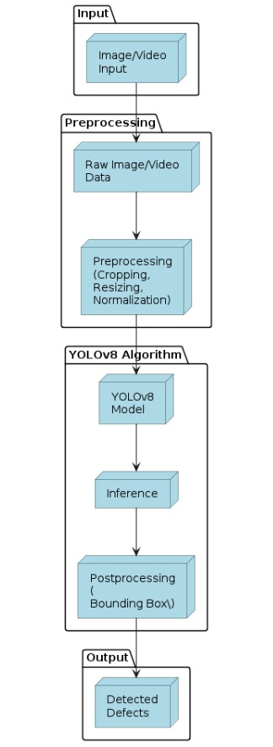
Block diagram for Interactive Cooking Guide.

Slide 15
MODULES
MODULE 1: Training dataset.
MODULE 2: Training YOLOv8 model.
MODULE 3: Integrating the trained model with webcam.
MODULE 4: Identifying defects with bound boxing

Slide 16
MODULE 1
Training Dataset
Objective : To train the dataset for training the model.
Tasks :
Data Collection: Gather a diverse dataset of images or videos showcasing various tire defects and non-defective tires.
Preprocessing: Resize and preprocess the images to fit the input requirements of YOLOv8.Model
Training: Train the YOLOv8 model on the preprocessed dataset to learn to detect tire defects.
Real-time Detection: Implement a real-time video capture pipeline with OpenCV to stream webcam footage.
Object Detection: Apply the trained YOLOv8 model to each frame of the webcam stream to detect tire defects.
Visual Feedback: Overlay bounding boxes or labels on the webcam feed to indicate detected defects in real-time.

Slide 17
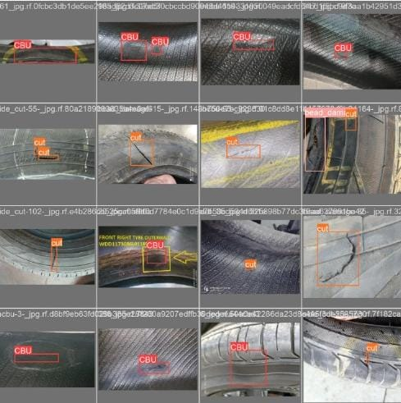
Training the dataset with annotated images

Slide 18
MODULE 2
Training YOLOv8 Model
Objective : The objective is to train the YOLOv8 model to accurately detect objects in images, optimizing it for robust performance in object detection task.
Tasks :
Data Preparation: Preprocess the training dataset to ensure compatibility with the YOLOv8 model, including resizing images and generating corresponding label files in the YOLO format.
Model Initialization: Initialize the YOLOv8 model with pre-trained weights, allowing for transfer learning to leverage knowledge from similar tasks.
Training Configuration: Configure training parameters such as learning rate, batch size, and number of epochs to optimize model convergence and performance.
Model Training: Train the YOLOv8 model on the prepared dataset, iterating through multiple epochs to minimize the loss function and improve object detection accuracy.

Slide 19
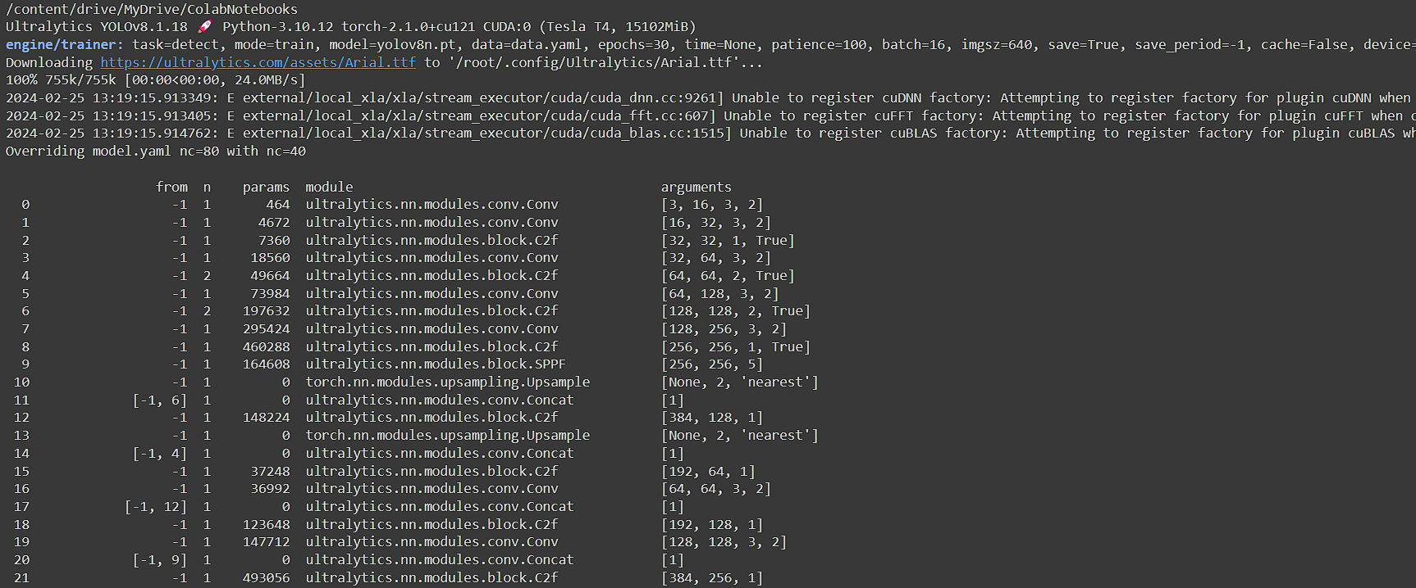
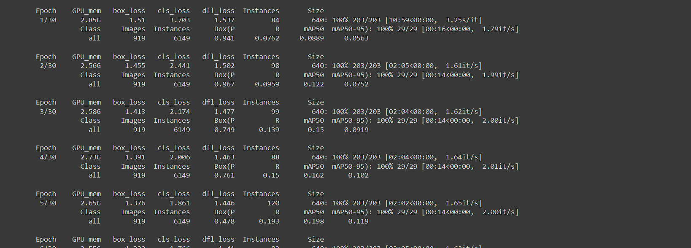
TRAINING IMAGES

Slide 20
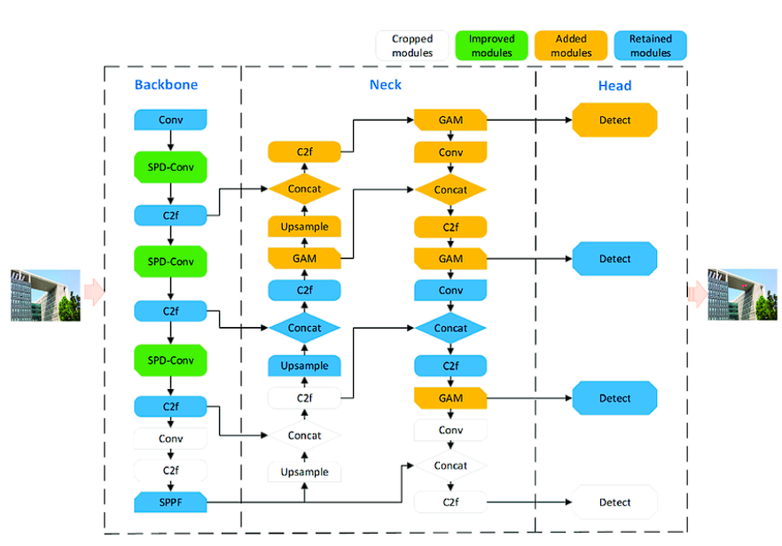
YOLOv8 Model Layers

Slide 21
MODULE 3
Integrating with web cam
Tire defect detection system involves capturing video frames from the webcam in real-time. These frames are then processed using computer vision algorithms to detect and classify various types of defects, such as cuts, bulges, or tread wear, present on the surface of the tires. The system can utilize techniques like image segmentation, feature extraction, and machine learning to accurately identify and analyze defects. Upon detection, the system may provide visual feedback, such as highlighting the location and type of defect, and can also log data for further analysis or reporting. Additionally, integrating with a webcam enables seamless deployment of the defect detection system for real-world applications, such as automotive maintenance or quality control in manufacturing.

Slide 22
MODULE 4
Identifying Defect with bound boxing
Integrating webcam-based tire defect detection involves capturing live video feed and employing computer vision algorithms to analyze each frame for abnormalities like cuts, bulges, or tread wear. Through bounding box techniques, the system accurately delineates the identified defects within the video stream, offering visual cues for easy recognition. Real-time feedback with bounding boxes facilitates swift identification and assessment of tire issues, enabling timely maintenance interventions to ensure road safety and operational efficiency. This approach optimizes defect identification processes, making it applicable across diverse sectors including automotive maintenance, manufacturing quality control, and logistics. By leveraging advanced image processing techniques, the system enhances defect detection accuracy and minimizes manual inspection efforts, enhancing overall productivity and safety standards in tire-related operations.

Slide 23
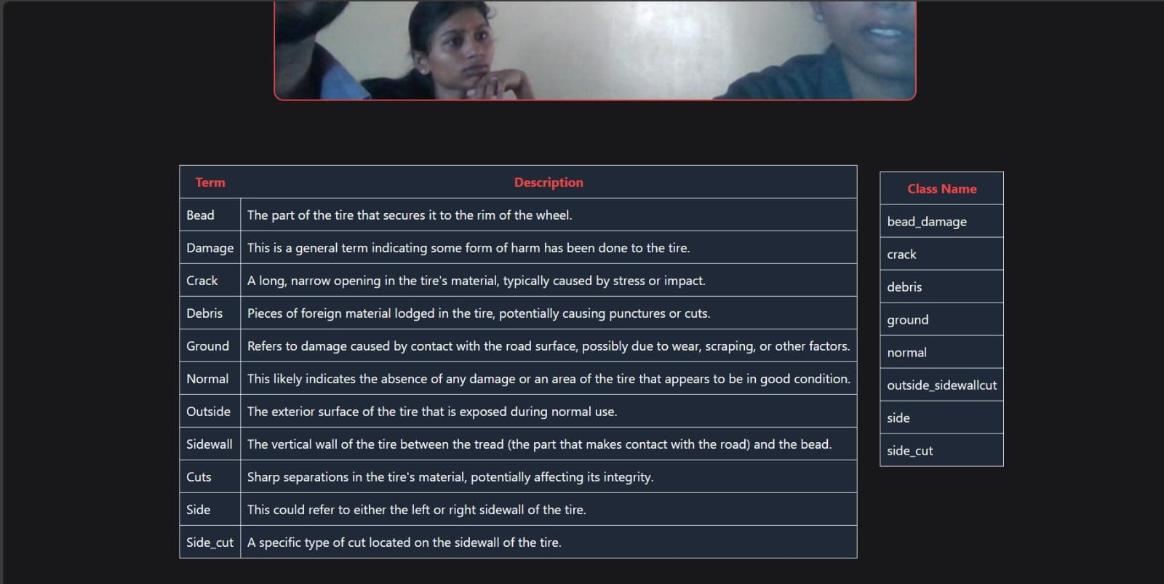
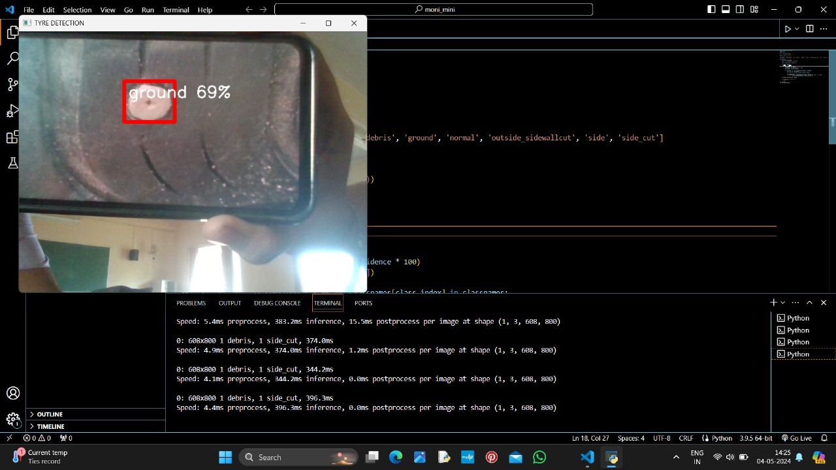
OUTPUT SCREENSHOTS

Slide 24
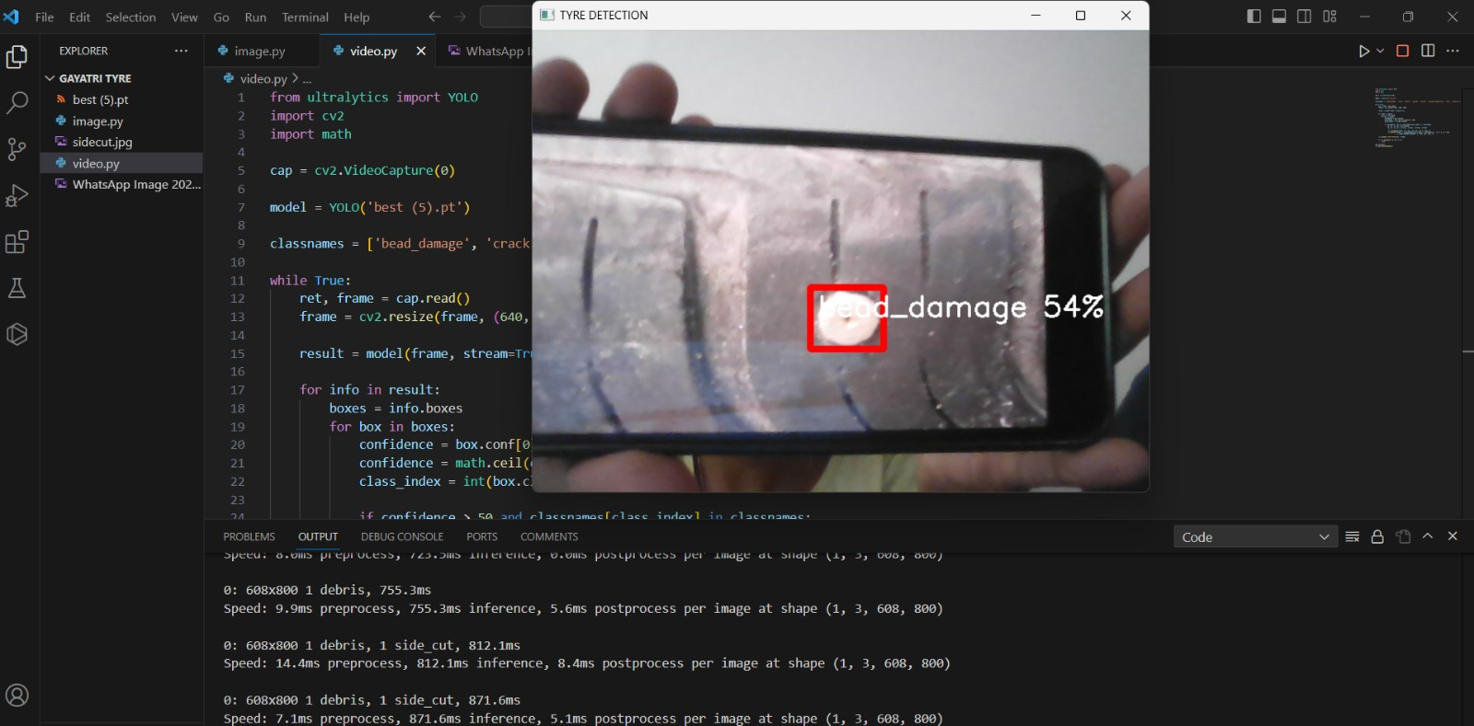
OUTPUT SCREENSHOTS

Slide 25
CONCLUSION
In conclusion, the implementation of the YOLOv8 algorithm for real-time tire defect detection has shown promising results, demonstrating the model's ability to accurately and efficiently identify defects in tires from live video feeds. By leveraging the robustness and speed of YOLOv8, we have developed a system capable of detecting various types of defects in real time, which could be invaluable for enhancing quality control processes in tire manufacturing facilities. Further optimization and integration with automated inspection systems could lead to significant improvements in efficiency and cost-effectiveness for the industry..

Slide 26
FUTURE SCOPE
Enhanced Detection Capabilities: Continuously improve the model's accuracy and robustness by expanding the dataset with more diverse examples of tire defects. This could involve collecting and labeling additional images from various sources to cover a wider range of defect types and conditions.
Automated Repair and Rework: Explore the possibility of integrating automated repair or rework systems with the defect detection system to streamline the corrective action process. This could involve robotic systems capable of repairing minor defects or automatically diverting faulty tires for manual inspection and repair.
On-device Inference: Optimize the model for deployment on edge devices such as industrial cameras or embedded systems. This would enable real-time inference directly on the device without the need for continuous internet connectivity or reliance on cloud-based processing.

Slide 27
REFERENCES
Zhao, G. & Qin, S. High-precision detection of defects of tire texture through X-ray imaging based on local inverse difference moment features. Sensors 18(8), 2524 (2018).
Zheng, Z. et al. Defect inspection in tire radiographic image using concise semantic segmentation. IEEE Access 8, 112674–112687 (2020).
Li, Y. et al. A novel severity calibration algorithm for defect detection by constructing maps. Inf. Sci. 607, 1600–1616 (2022).
Das, S., Anandi, D. & Srinivas, R. G. Applying Bayesian data mining to measure the effect of vehicular defects on crash severity. J. Transport. Saf. Security 13(6), 605–621 (2021).
Behroozinia, P., Khaleghian, S., Taheri, S. & Mirzaeifar, R. Damage diagnosis in intelligent tires using timedomain and frequency-domain analysis. Mech. Based Des. Struct. Mach. 47(1), 54–66 (2019).

Slide 28
THANK YOU !

